Slide 1
Performance of focal alone
COMPETITOR 1
N = 0
N = 2
N = 4
N = 8
Focal with competitor 1 only
N = 0
N = 2
COMPETITOR 2
HOIs possible between competitors 1 and 2
N = 4
N = 8
Focal with competitor 2 only
Focal with competitors 1 and 2

Slide 2

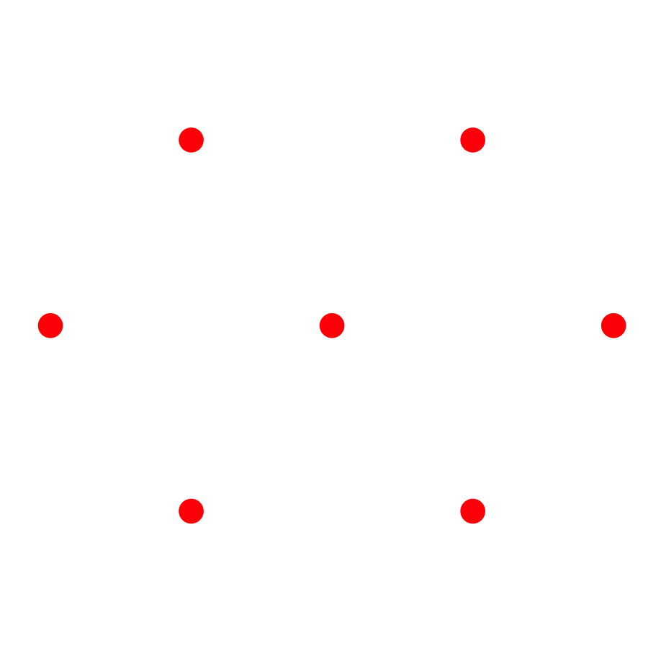
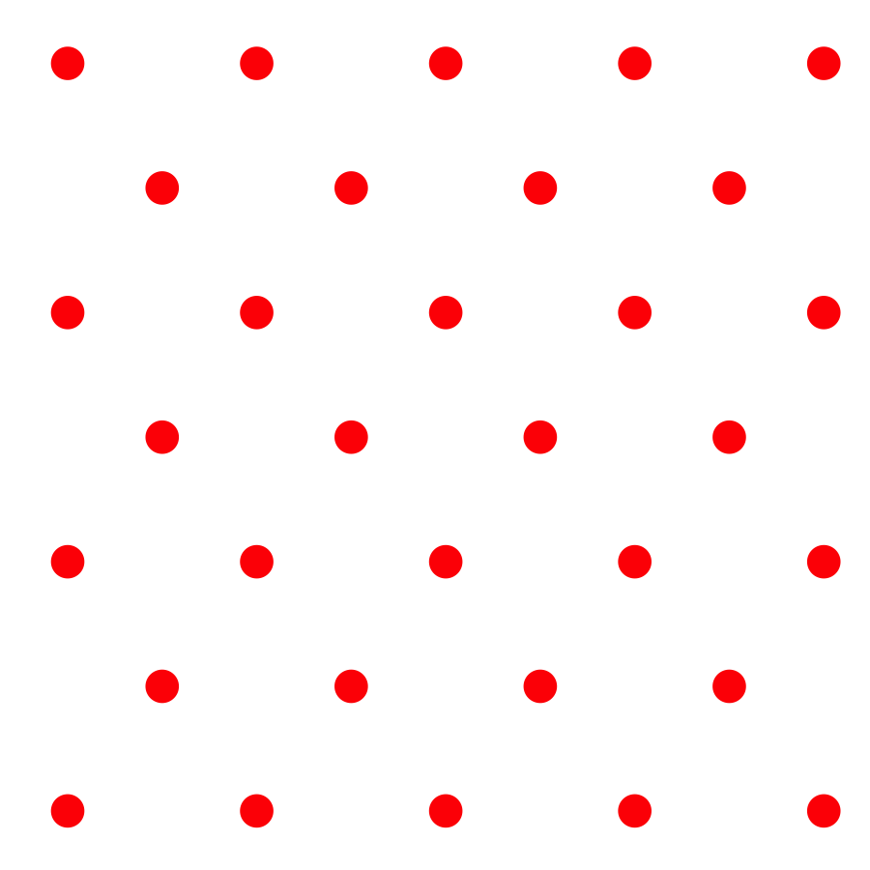

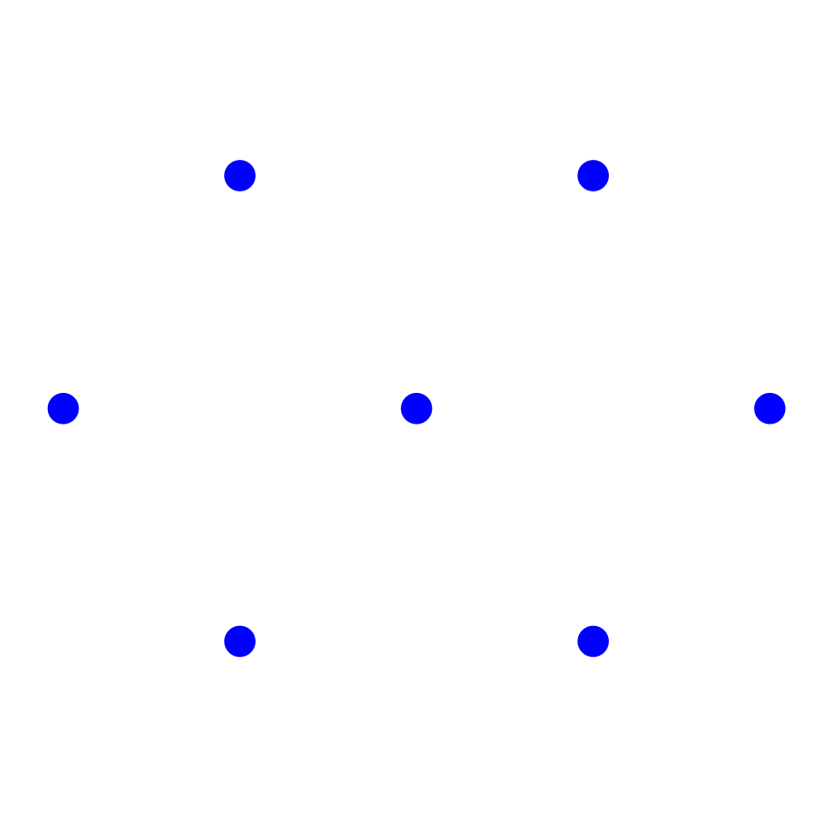
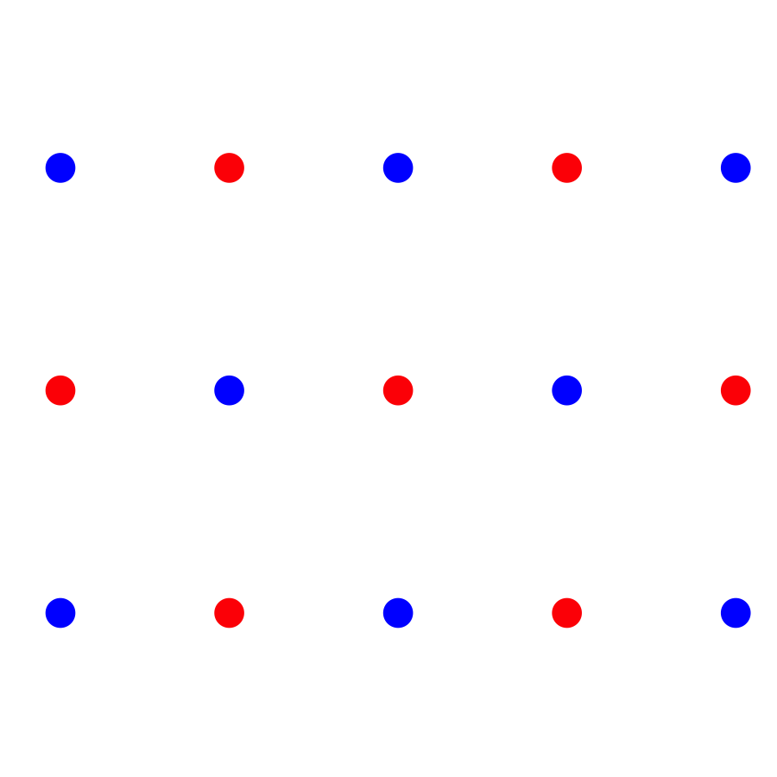
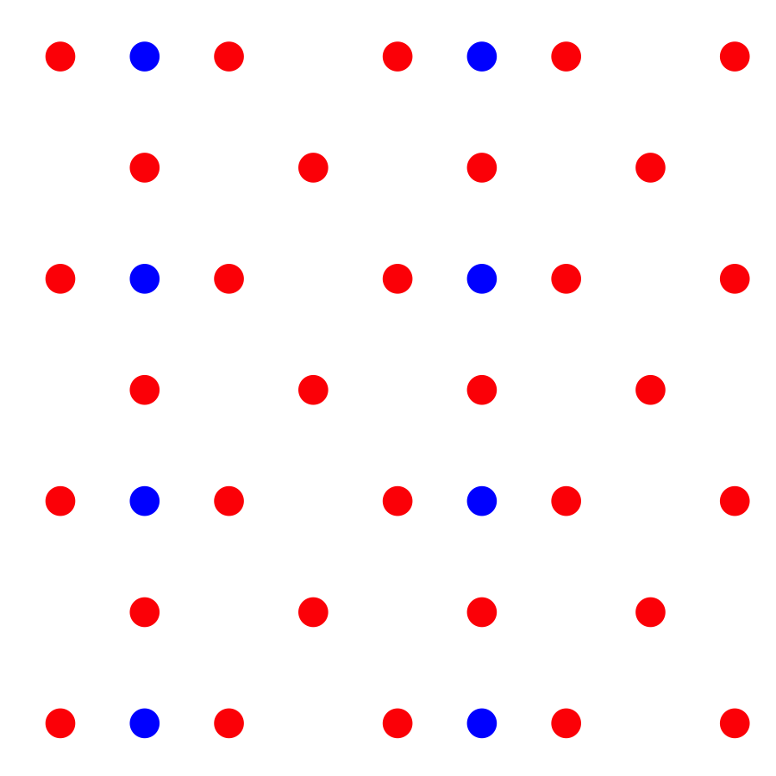
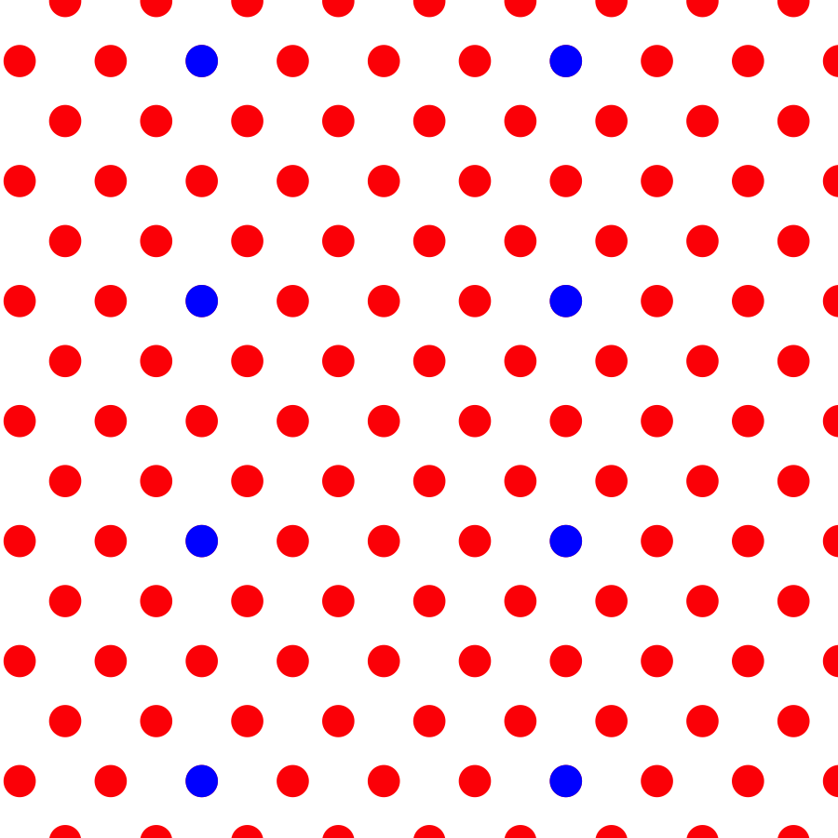
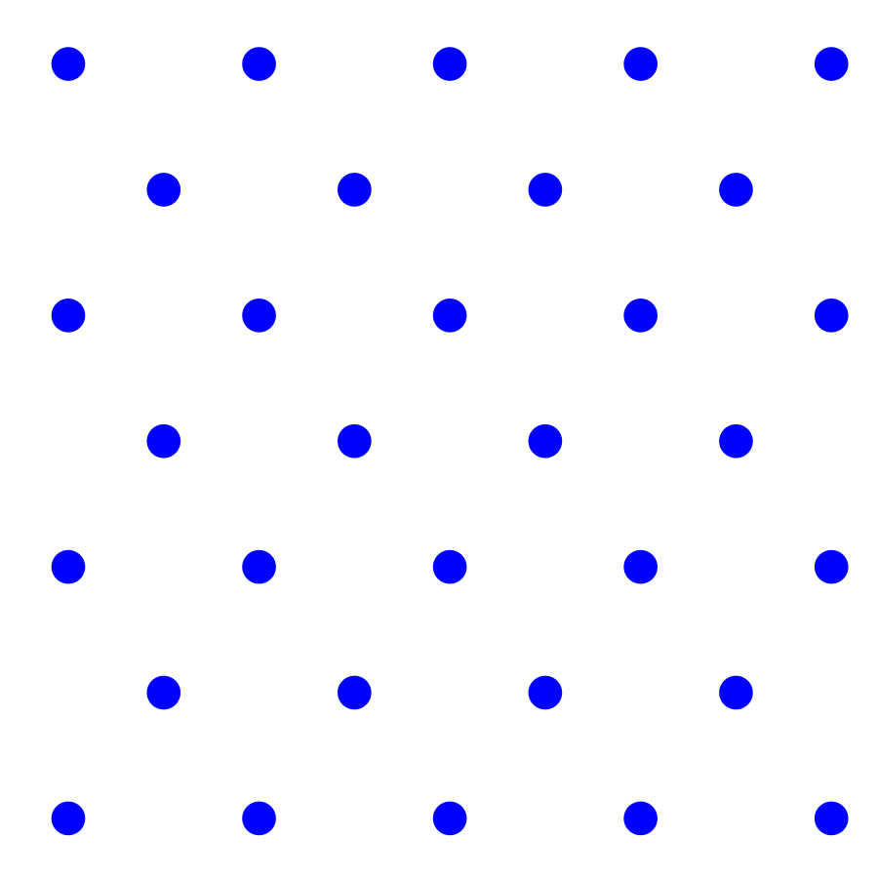
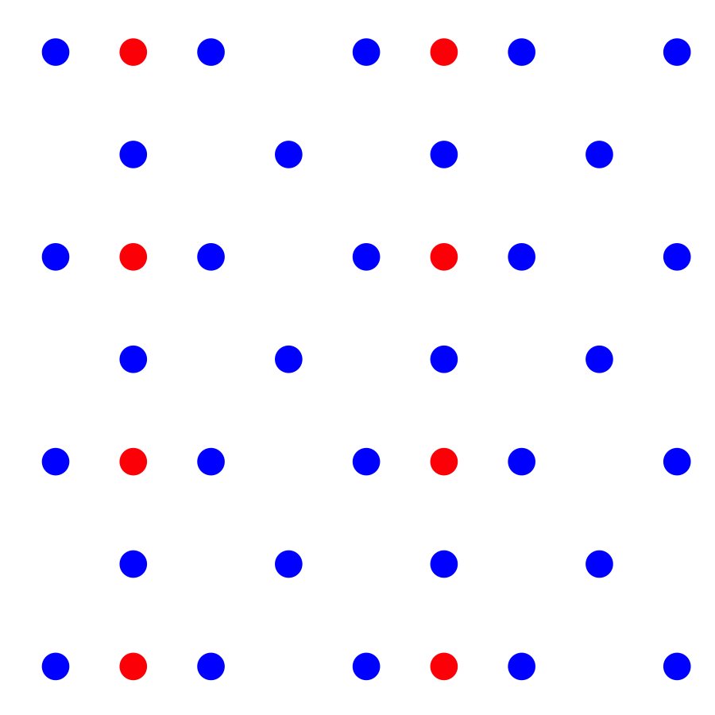
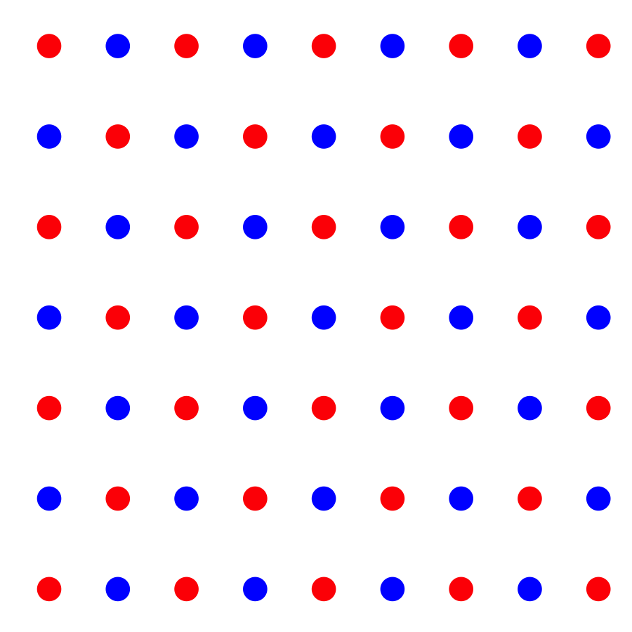
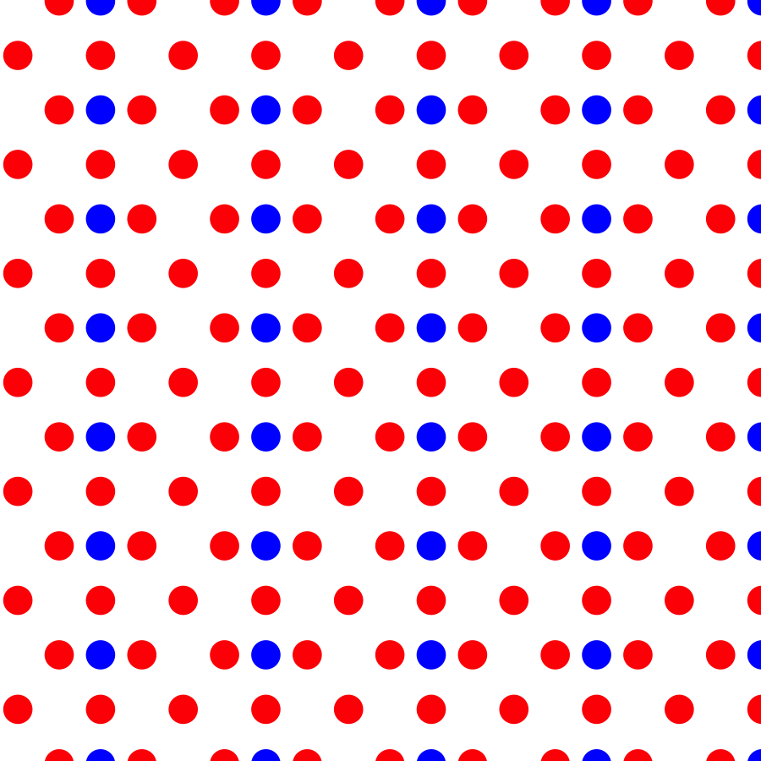

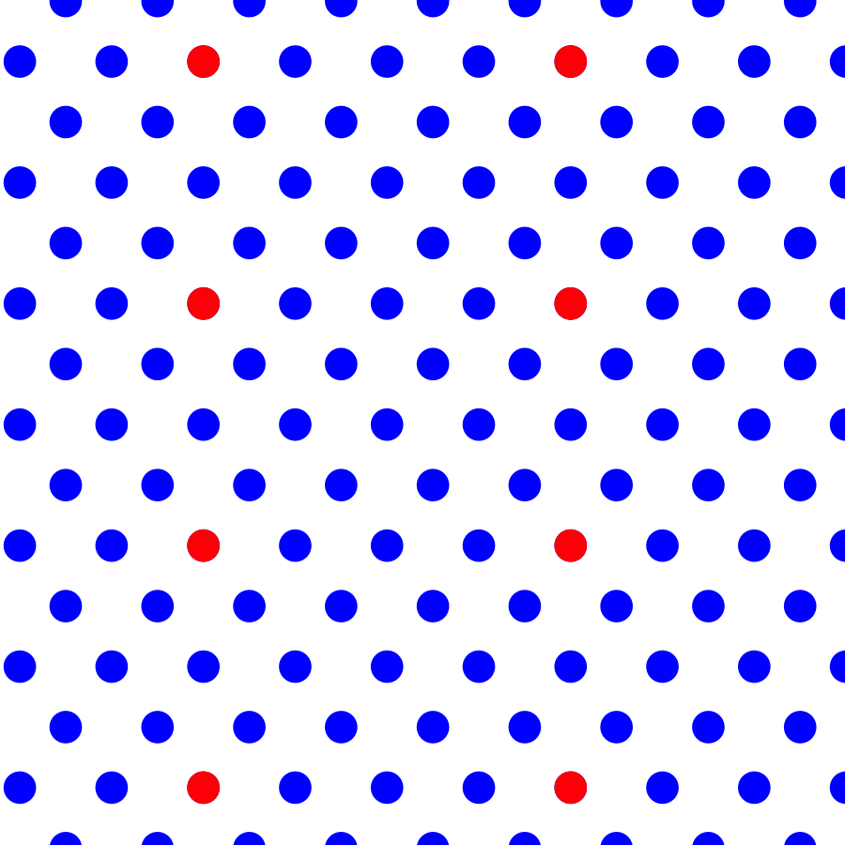

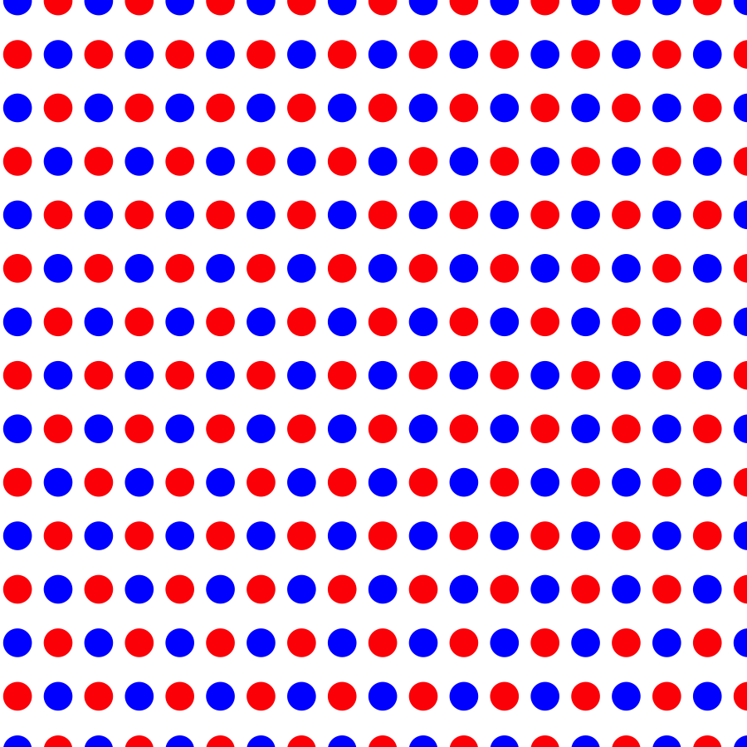

Focal Individual (green)
Density of competitor 1 (red)
0
2
4
8
0
2
Density of competitor 2 (blue)
HOIs possible between competitors 1 and 2
4
8

